Slide 1

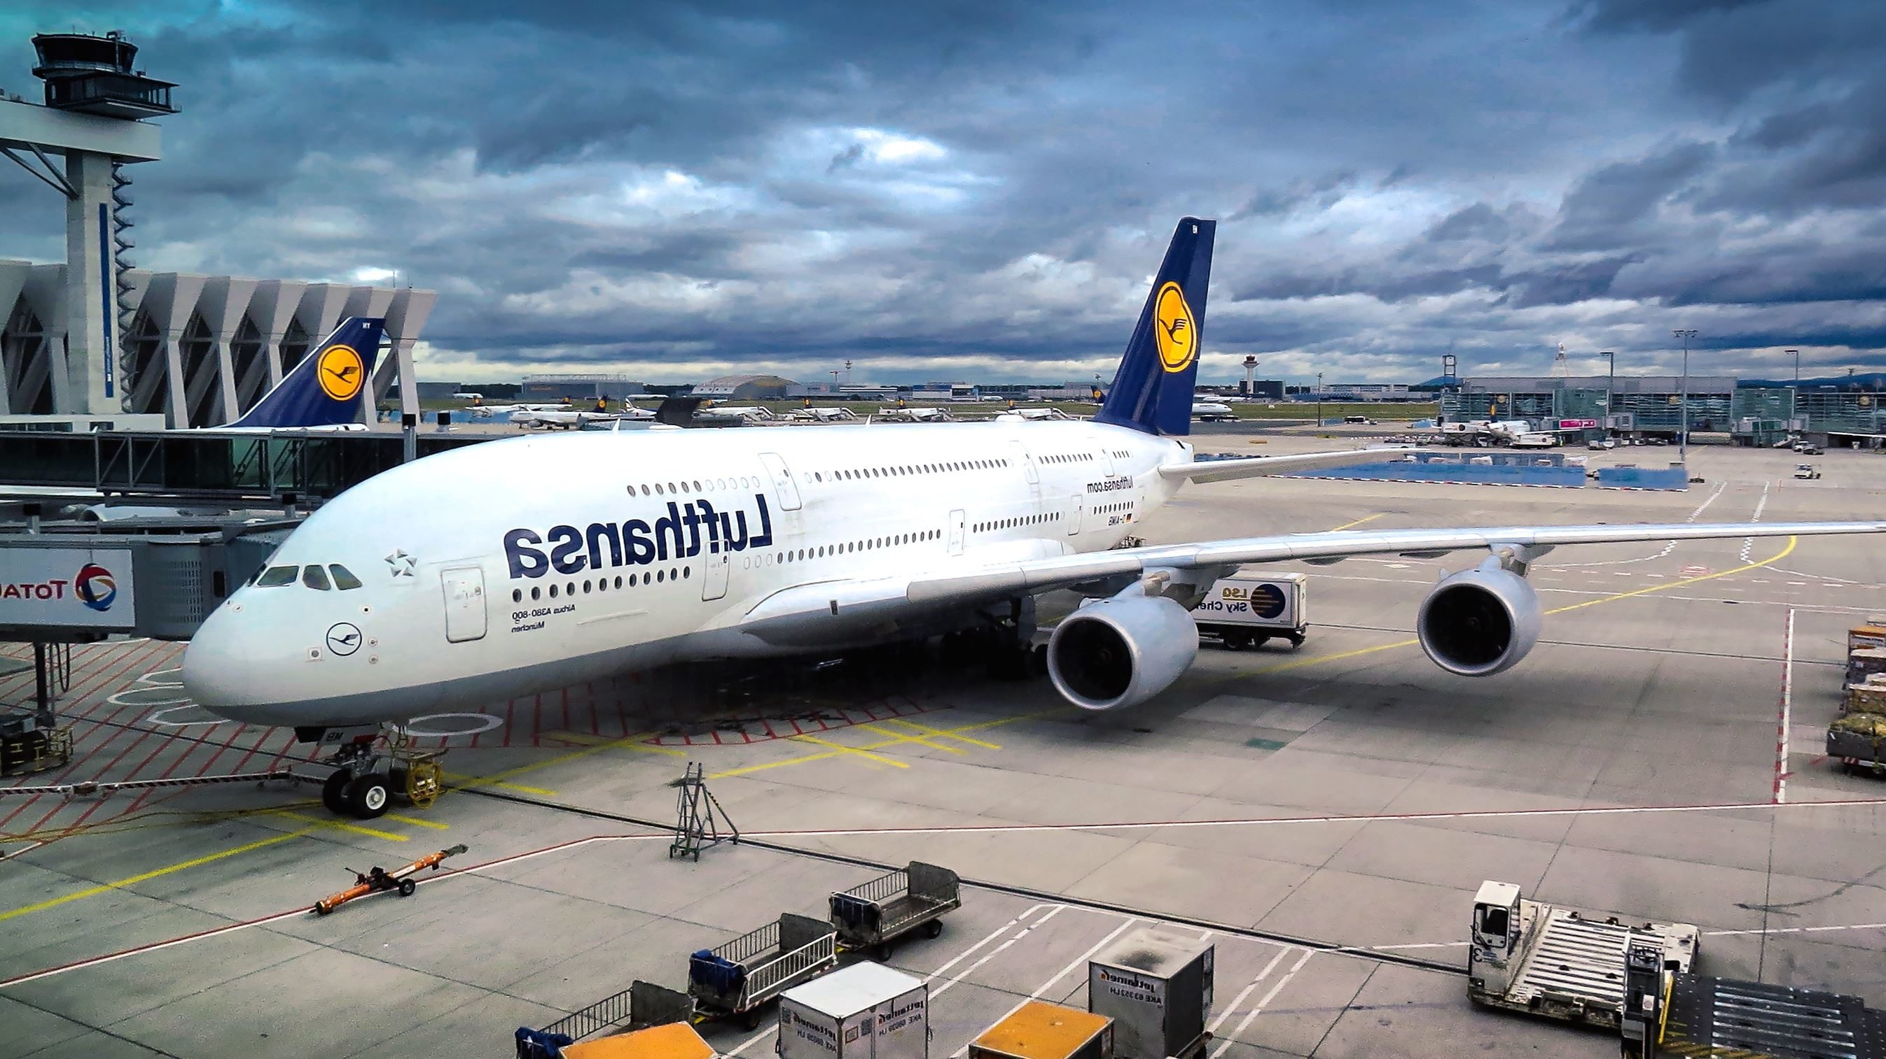
AIRLINE RESERVATION SYSTEM
SPRINT - 2

Slide 2

Presented By: Nithin Kumar Pendam Batch: RDBMS (PL/SQL) Sep 2nd Under the Guidance of: Ajay Kumar Nerumati Mentor: Devangana Mandal

Slide 3

DASHBOARD
SPRINT 1:
ER Diagram
Creating Tables
Procedures
Functions
Exceptions
SPRINT 2:
SDLC
Creating Tablespaces
Creating Users & giving Privileges
Packages
Tuning Methods:
Hints
Obfuscation
Bulk Binds
Pragmas
Redo Log Multiplexing
Materialized Views
Indexes
Joins
MongoDB
Testing

Slide 4

Table of Contents:
OBJECTIVE
ABSTRACT
INTRODUCTION
IMPLEMENTING SDLC MODEL
REQUIREMENT PHASE
TECHNOLOGY USED
DESIGN PHASE
DEVELOPMENT PHASE
IMPLEMENTING PHASE
SPRINT 2:
TUNING PHASE
TESTING PHASE
MAINTAINENCE PHASE
SUMMARY

Slide 5

OBJECTIVE:
Designing the Database, developing the Queries & Basic Reports required with Performance Tuning for Airline Reservation System

Slide 6

ABSTRACT
Designing a Central Air-Reservation Database that helps Customer for easy Flight Booking, that to be used by all Booking Offices. This Database is to be used by Front End Systems and it also requires some Backend query and procedure designing.

Slide 7

INTRODUCTION
This Project is to Design the Database, Reports the queries related to Warehouse Airline Reservation System and performing Performance Tuning on Database & PL/SQL Code.

Slide 8
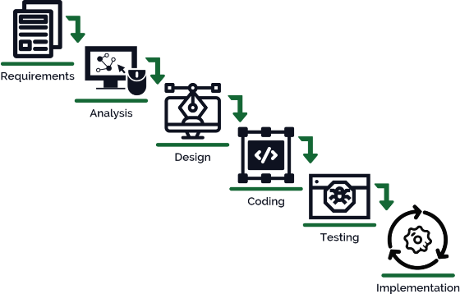
SDLC MODEL: WATERFALL MODEL
Software Development Life Cycle is a set of
Processes, standards & tools used to develop,
alter Software in a optimal manner.
The Waterfall Model is a classical model
Used in Software Development Life
Cycle (SDLC) to create a software with
a Linear and Sequential approach.
Deployment
&
Maintenance

Slide 9


REQUIREMENT PHASE
Minimum System Requirements:
Physical Memory (RAM) 1GB Minimum
Disk Space Total 5GB
Processor 550 MHz Minimum
Video Adapter 256 Colors

Slide 10

Technology used:
REQUIREMENT PHASE
Databases:
Oracle 11g Express Edition.
Oracle 19c Enterprise Edition.
MongoDB

Slide 11

DESIGN PHASE
Entity Relationship Diagram.
TABLE’s Used.

Slide 12
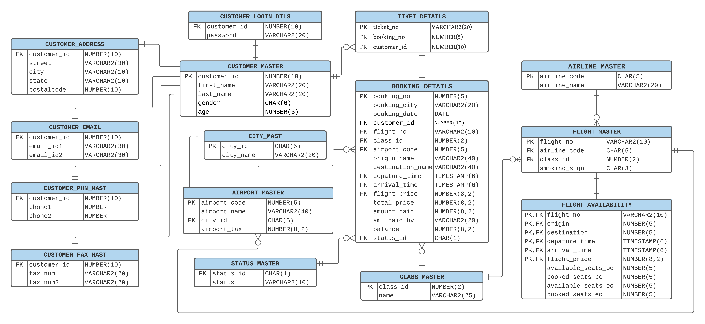
Entity Relationship Diagram

Slide 13
TABLES USED
TABLES USED
CUSTOMER_MASTER
CUSTOMER_ADDRESS
CUSTOMER_FAX_MAST
CUSTOMER_PHN_MAST
CUSTOMER_EMAIL
CUSTOMER_LOGIN_DTLS
STATUS_MASTER
CLASS_MASTER
CITY_MAST
AIRLINE_MASTER
AIRPORT_MASTER
FLIGHT_MASTER
FLIGHT_AVAILABILITY
BOOKING_DETAILS
TICKET_DETAILS

Slide 14
DEVELOPMENT PHASE
1.SQL
DQL, DDL, DML, TCL, DCL
JOINS & SUBQUERIES
2.PL/SQL
PROCEDURES
EXCEPTION HANDLINGS
FUNCTIONS
CURSORS
TRIGGERS
3.TUNING
PRAGMA’s
BULK BINDS
JOINS
PACKAGES
MATERIALIZED VIEWS
HINTS
INDEXES
REDO LOG MULTIPLEXING

Slide 15
IMPLEMENTATION PHASE (CODING)

Slide 16
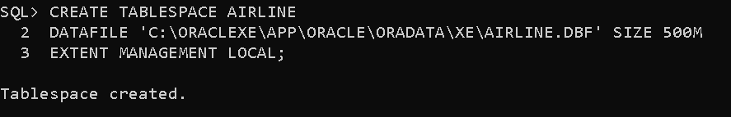
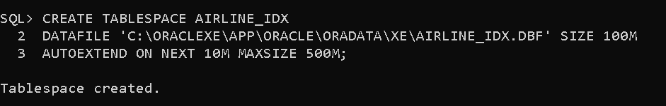
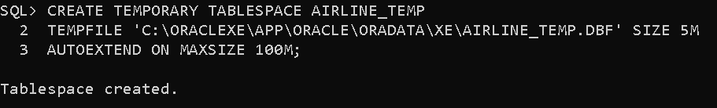
IMPLEMENTATION PHASE (CODING)
TABLESPACE Creation:-
DEFAULT TABLESPACE
INDEX TABLESPACE
TEMPORARY TABLESPACE

Slide 17
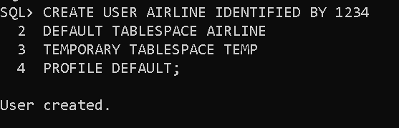
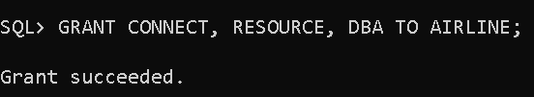
(Continue..)
Database USER Creation:-
Grant Permissions to USER :-

Slide 18
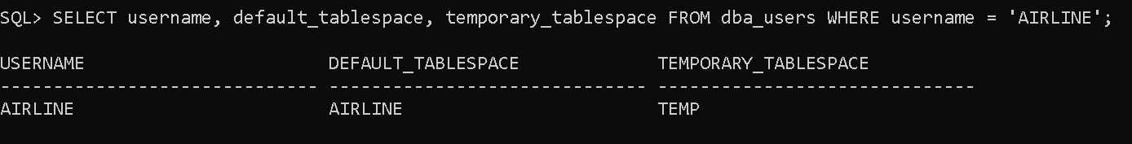
(Continue..)
Verifying User:

Slide 19
PROCEDURE 1:
Create a Procedure which gets Number_of_Bookings, Number_of_Emails, Number_of_Phones and Number_of_Faxes for each Customer. Customer_ID will be the Input to the Procedure.

Slide 20
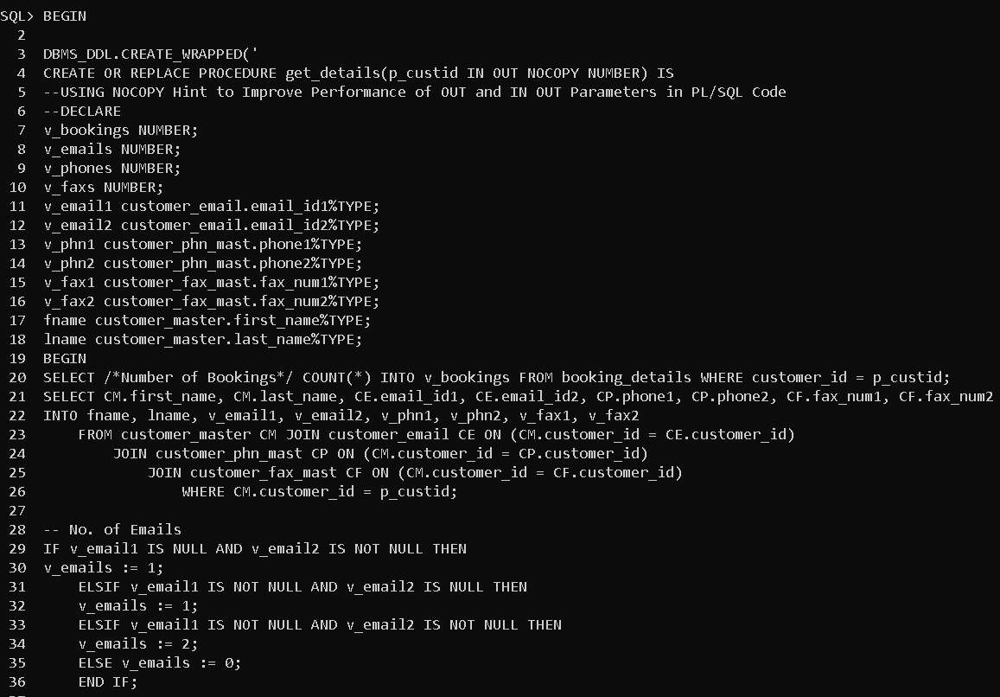
Procedure-1
Creation:

Slide 21
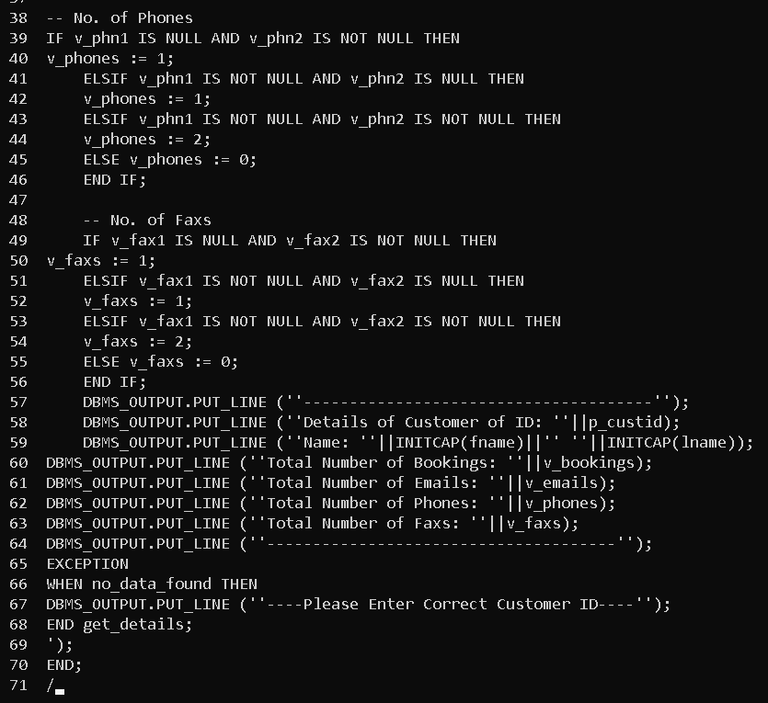
Procedure-1 Creation (Continue..):

Slide 22
PROCEDURE 2:
Create a Procedure which Display all Customer’s First_name, Last_name, Phone_no’s and Email’s, sort them by Customer_ID. Customer_ID will be the input to the Procedure.

Slide 23
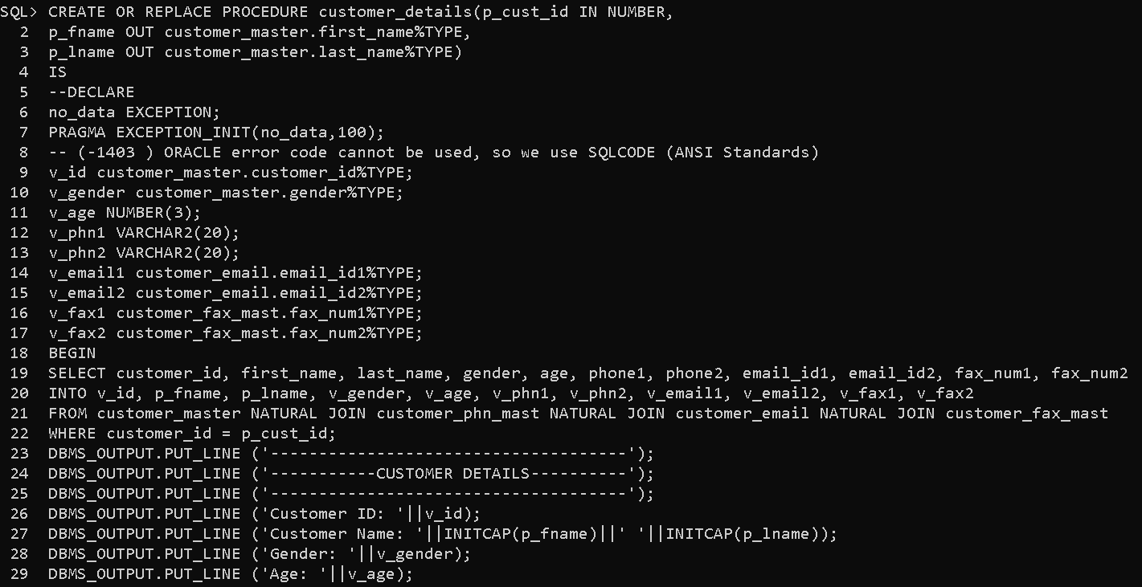
Procedure-2 Creation:

Slide 24
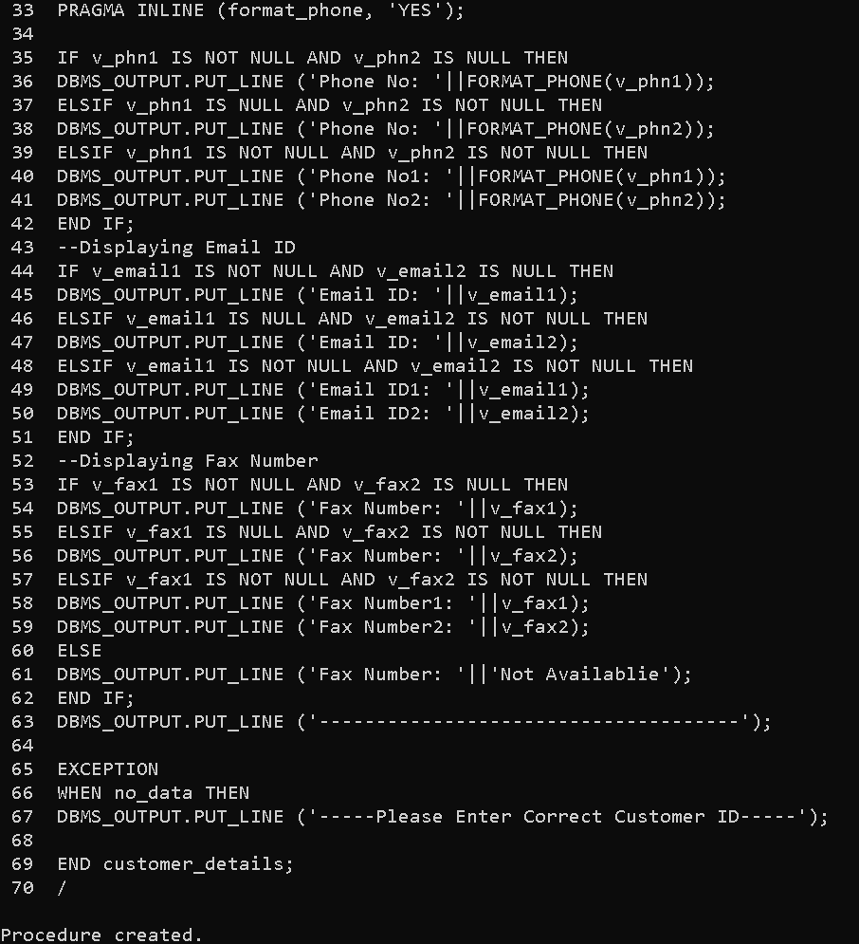
Procedure-2 Creation
(Continue..):

Slide 25
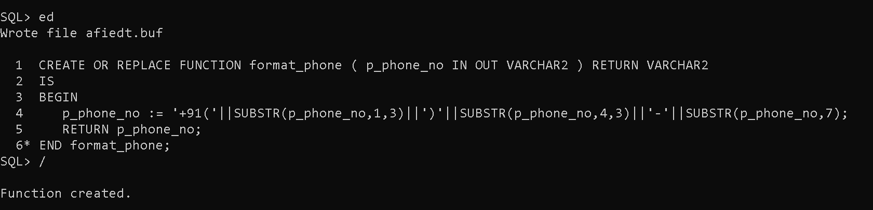
Function used in Procedure-2:

Slide 26
PROCEDURE 3:
Create a Procedure which will give list of all Customer’s who did not place any Booking’s.

Slide 27
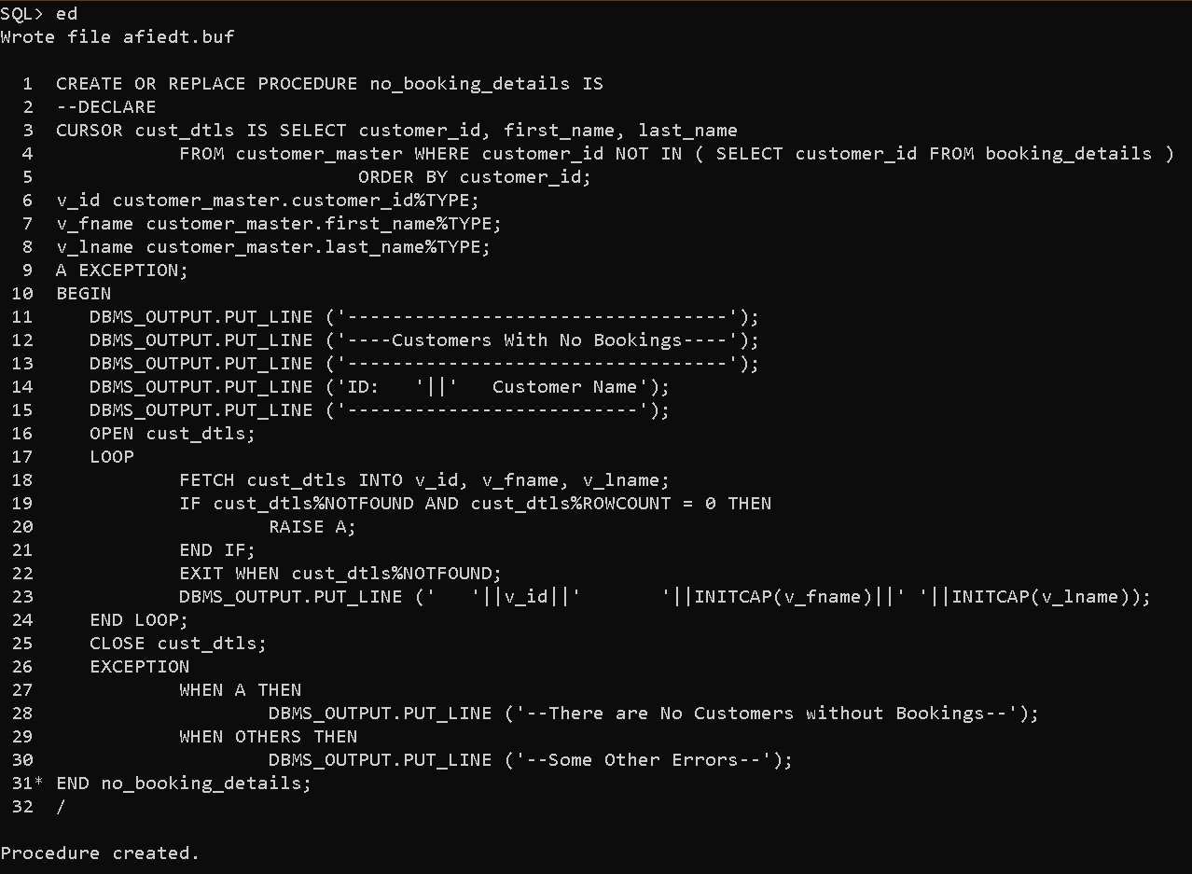
Procedure-3
Creation:

Slide 28
PROCEDURE 4:
Create a Procedure which will list of all Cancelled Booking’s, Please display Booking_no, Customer_id, Flight_no, Origin, Destination, Booking_city. Also sort by Booking_no, Customer_id and Flight_no.

Slide 29
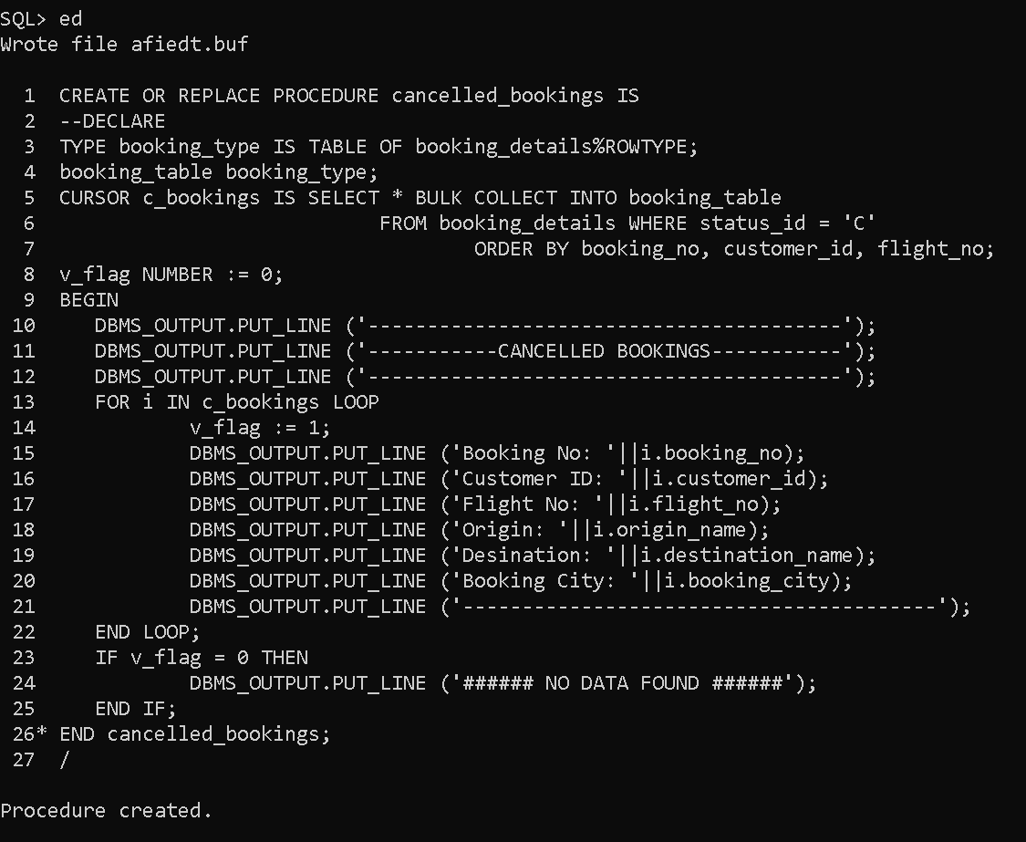
Procedure-4 Creation:

Slide 30
PROCEDURE 5:
Create a Procedure which do Transaction Processing i.e, a Customer must able to Book the Flight and the effects must go to Respective TABLE’s.

Slide 31
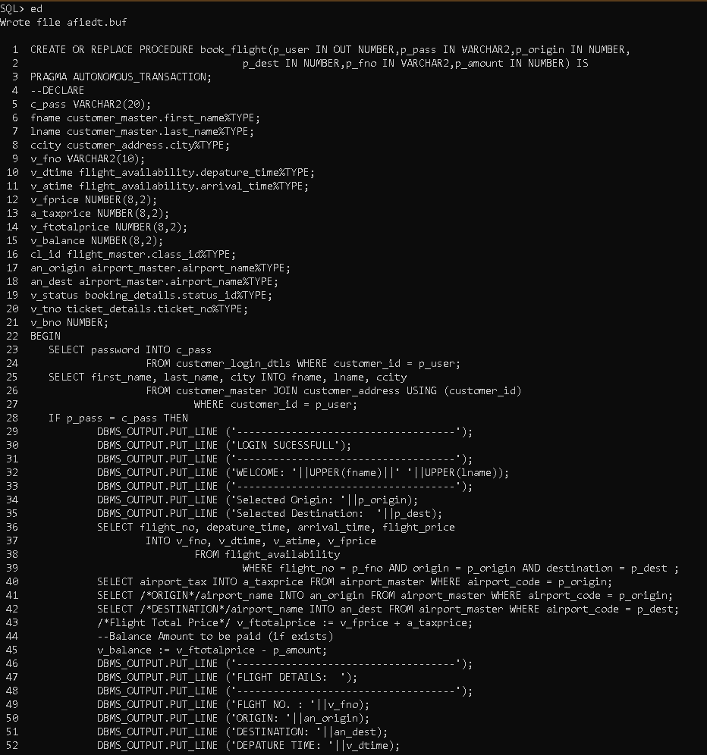
Procedure-5 Creation:-

Slide 32
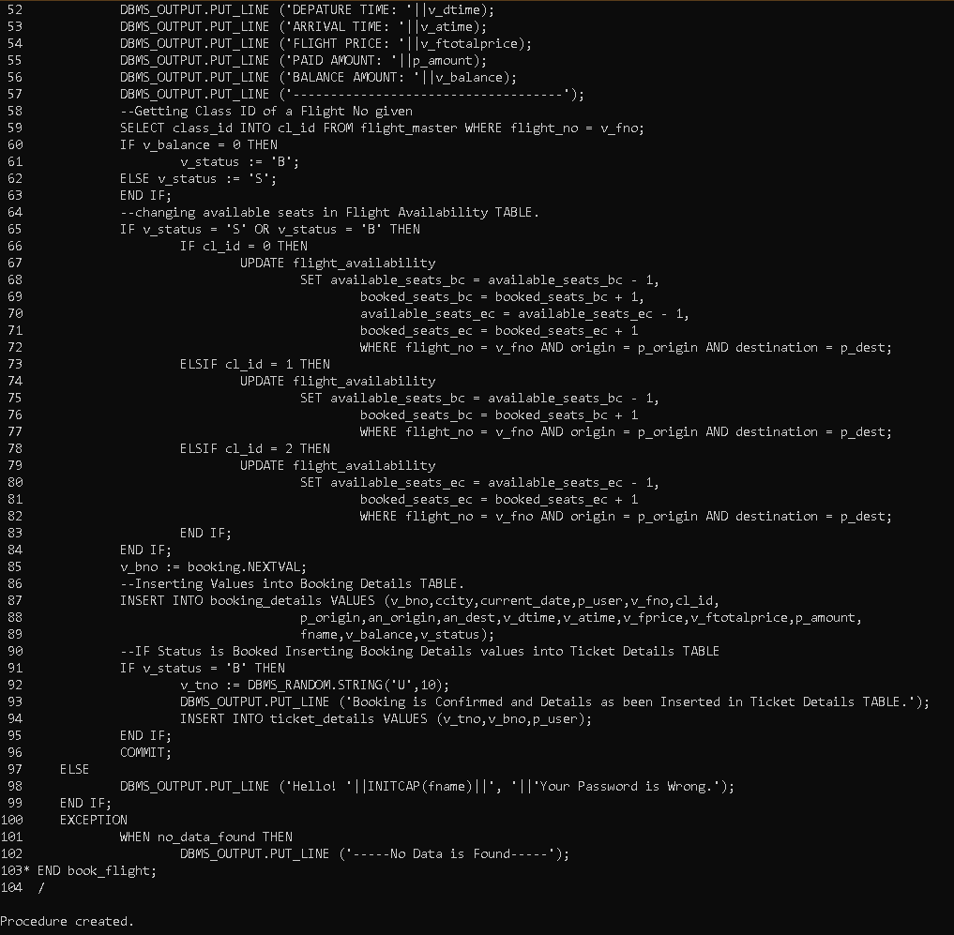
Continue..

Slide 33
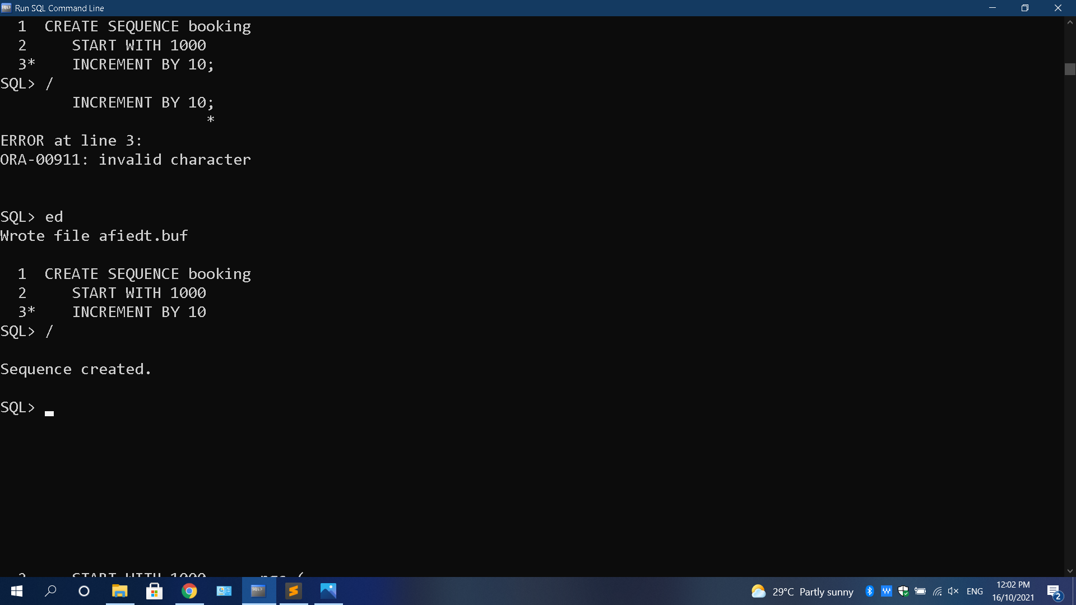
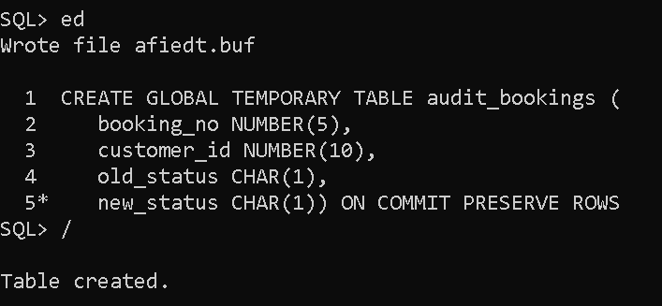
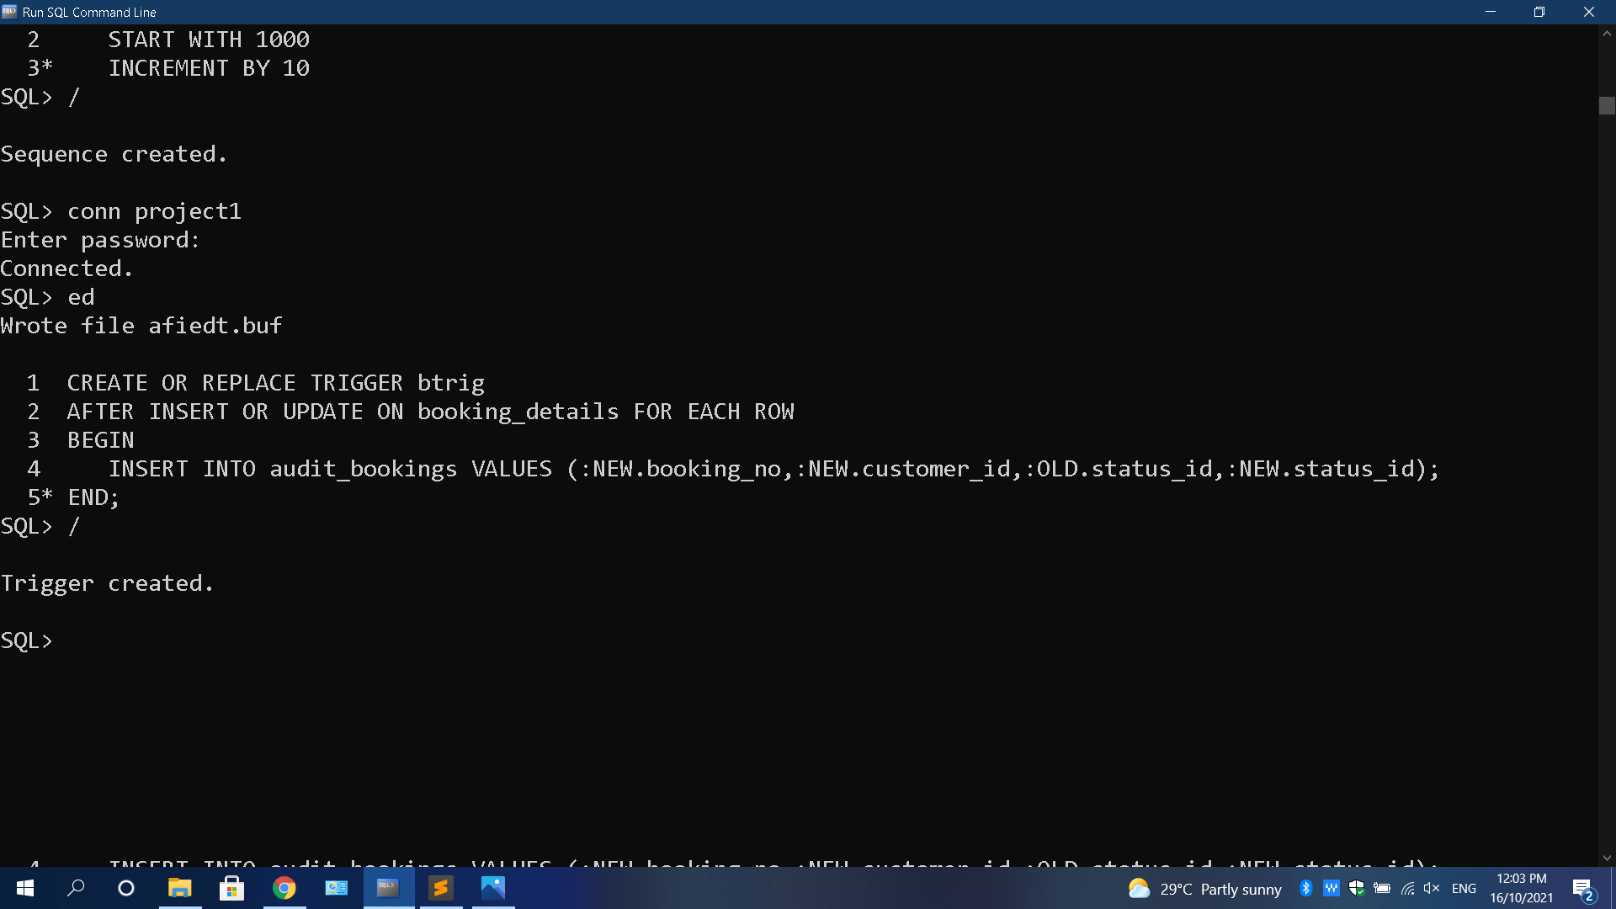
Sequence Used in Procedure 5:
Temporary Table Used:
Trigger Used in Procedure 5:

Slide 34
PROCEDURE 6:
Create a Procedure which do Transaction Processing i.e, a Customer must able to Cancel the Flight and the effects must go to Respective TABLE’s.

Slide 35
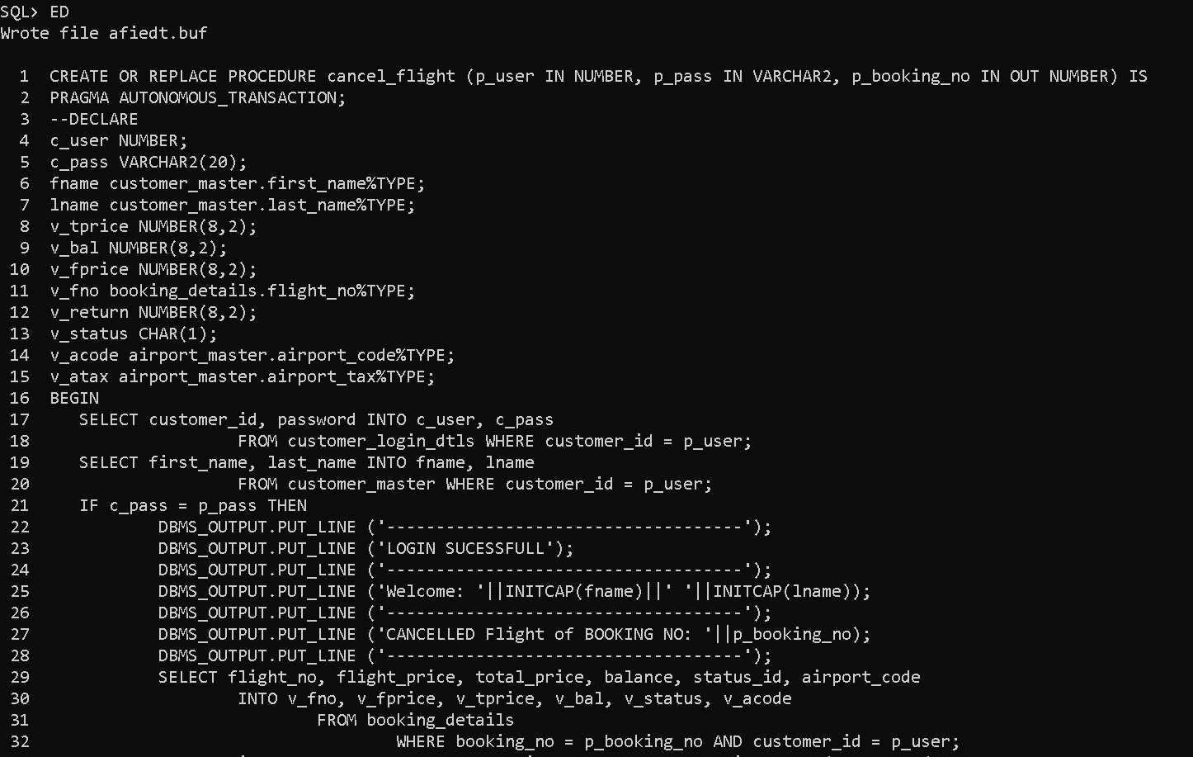
Procedure-6 Creation:

Slide 36
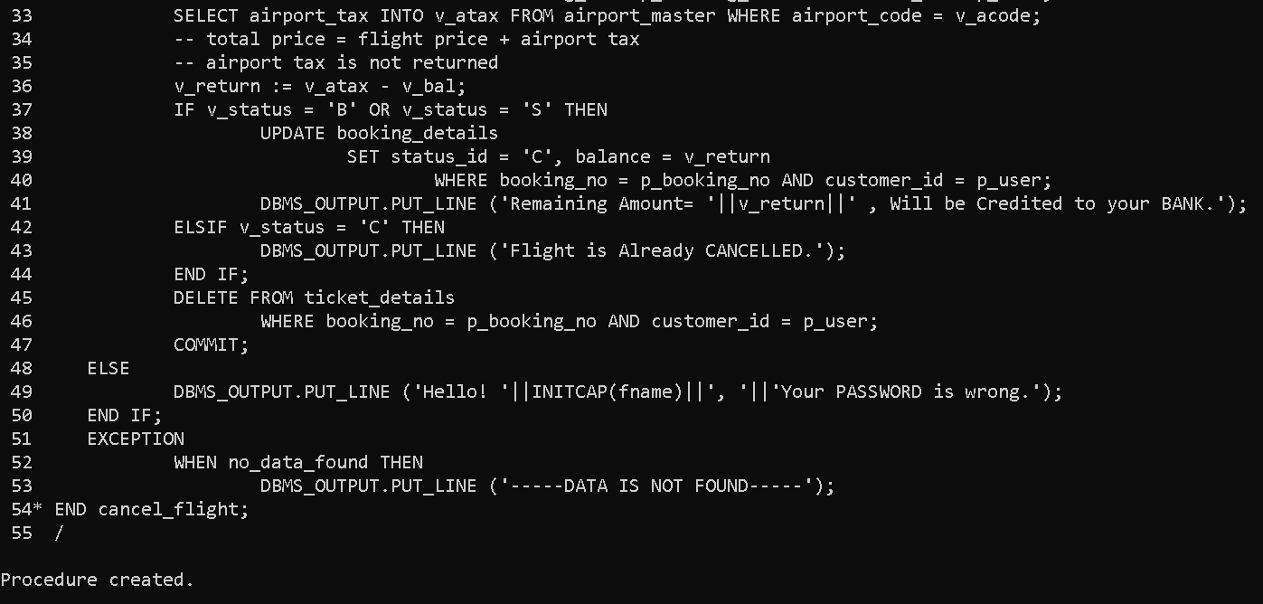
Procedure-6 Creation (Continue):

Slide 37
PL/SQL PACKAGE:
Package is a Schema Object that groups logically related PL/SQL types, variable, constants, subprograms, cursors and exceptions.
Included all Procedure’s we have created in a Single Package named ‘AIRLINE’.

Slide 38
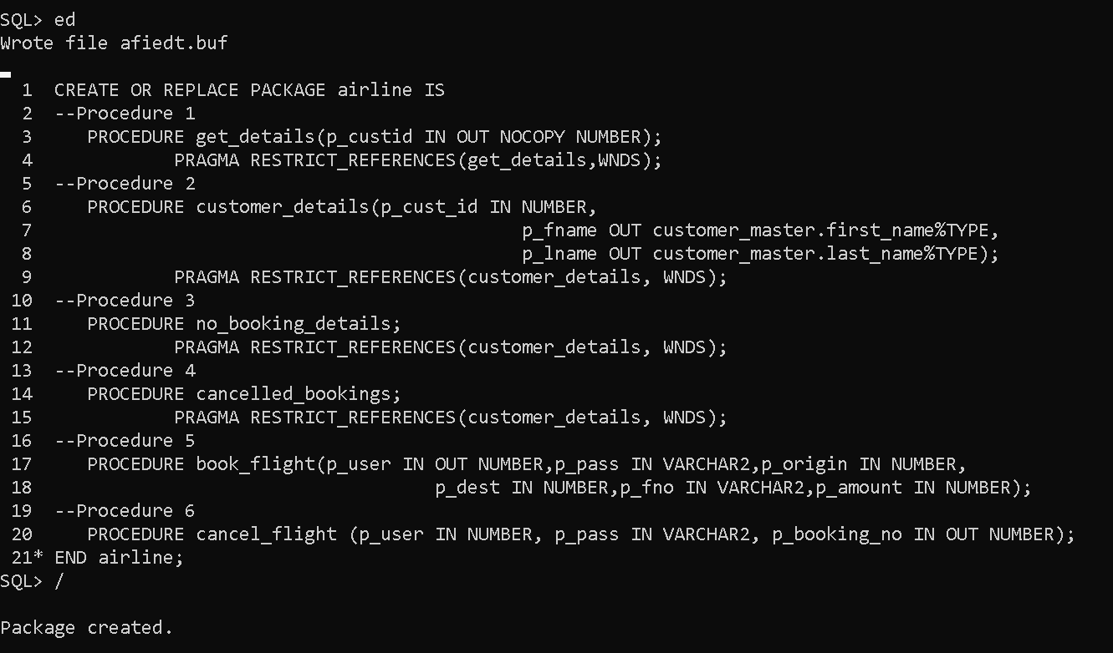
Package Specification Creation:

Slide 39
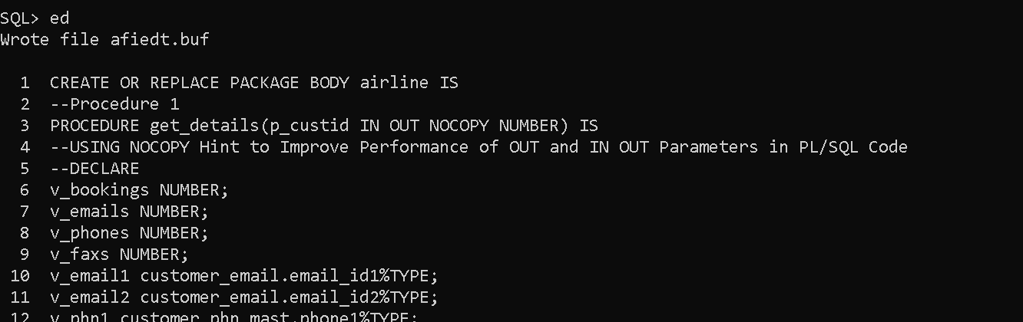
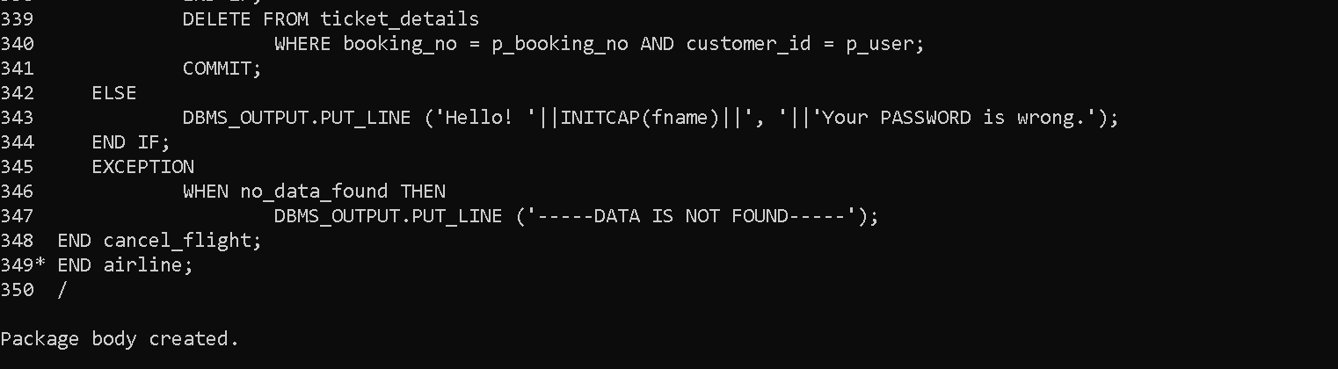
Package Body Creation:
:

Slide 40
TUNING PHASE:
Airline Reservation System has been created in our own created oracle database named “Airline” with some PL/SQL procedures, functions and packages.
This Airline Database has to be optimized with Database Tuning Methods.
Why is Tuning Required ?

Slide 41
HINTS:
We have used NOCOPY Hint in Procedure 1.

Slide 42
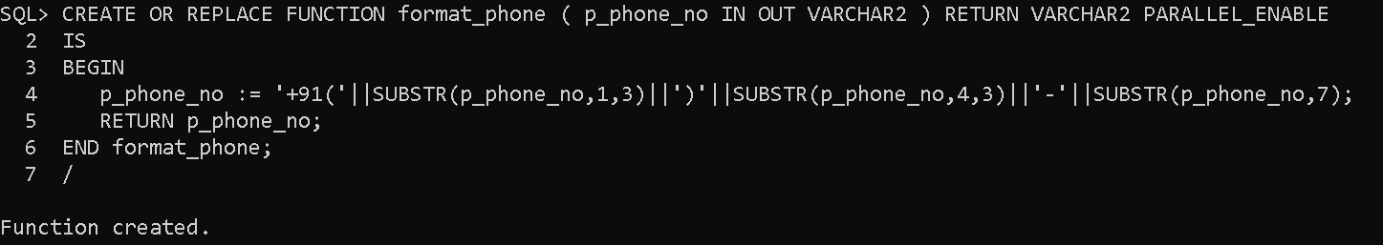
HINTS:
We have used PARALLEL ENABLE Hint in a Function (FORMAT_PHONE).

Slide 43
OBFUSCATION:
Dynamically Obfuscate(hiding) PL/SQL source code using DBMS_DDL Package.

Slide 44
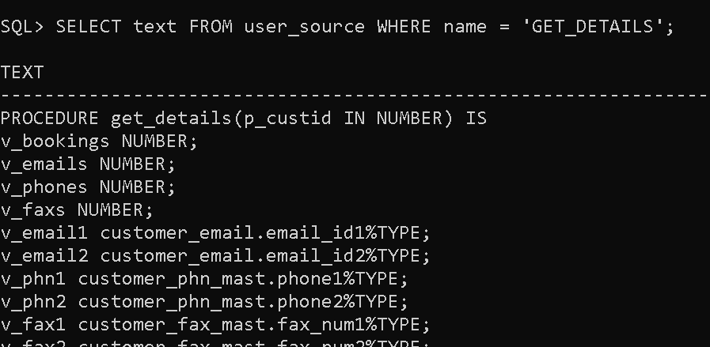
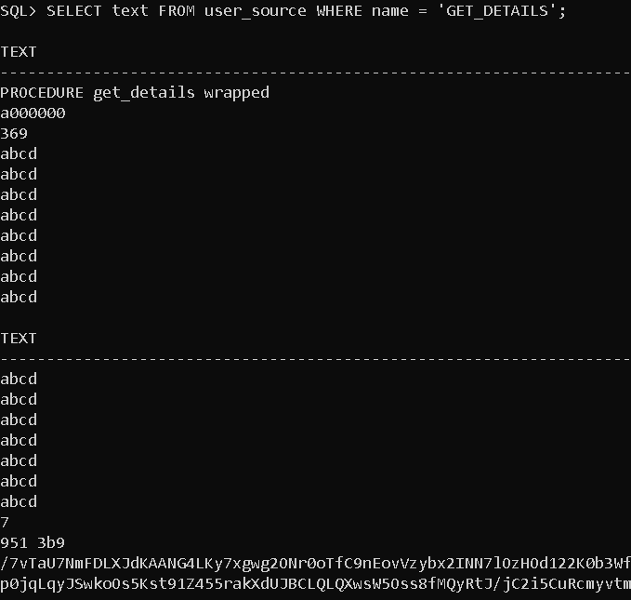
OBFUSCATION (TESTING):
BEFORE
AFTER

Slide 45
SUBPROGRAM INLINING:
Subprogram Inlining utilized in Procedure 2.
It can be controlled either by PLSQL_OPTIMIZE_LEVEL parameter or PRAGMA INLINE.

Slide 46
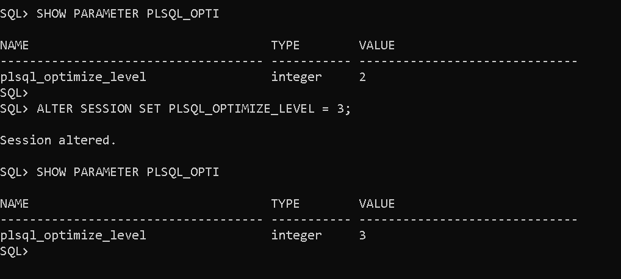
SUBPROGRAM INLINING (continue..):
by PLSQL_OPTIMIZE_LEVEL parameter

Slide 47
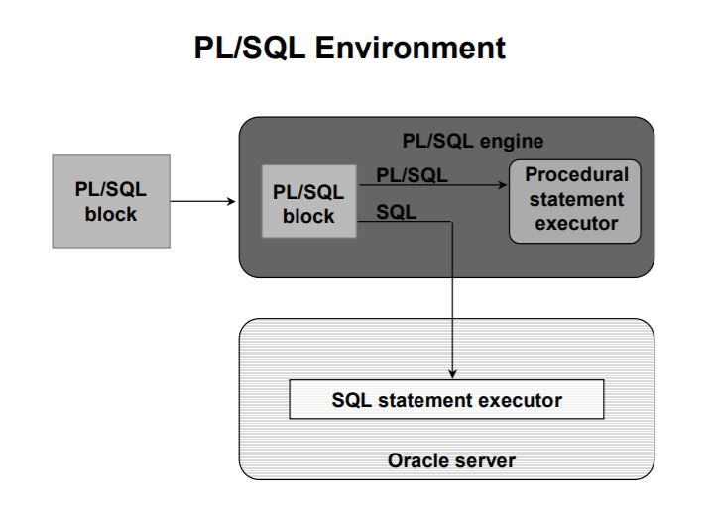
BULK BINDS:
Oracle uses two engines to process PL/SQL code.

Slide 48
BULK BINDS:
Utilization of Bulk Collect in Procedure 4.

Slide 49
PRAGMA
PRAGMA EXCEPTION_INIT utilized in Procedure 2.

Slide 50
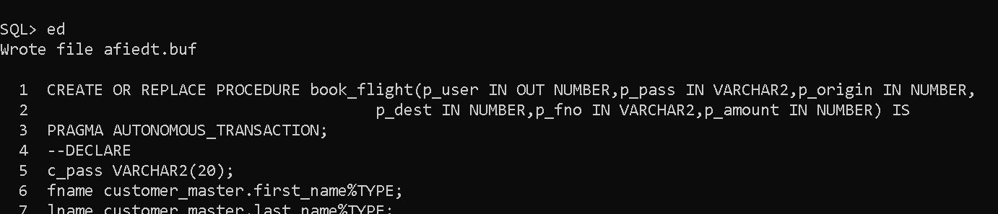
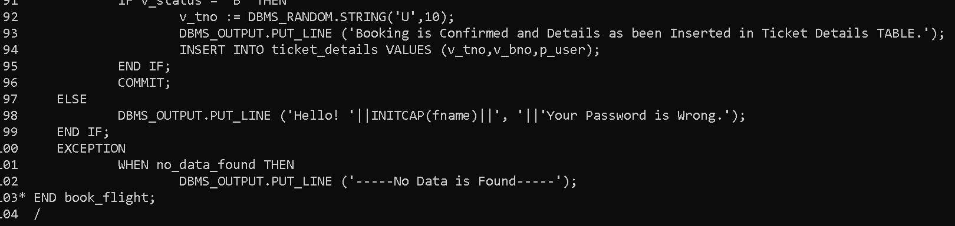
PRAGMA
PRAGMA AUTONOMOUS_TRANSACTION utilized in Procedure 5 & 6.

Slide 51
PRAGMA
PRAGMA RESTRICT_REFERENCES utilized in Package created “Airline”.

Slide 52
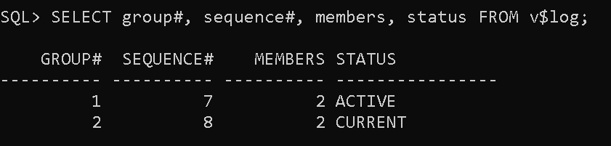
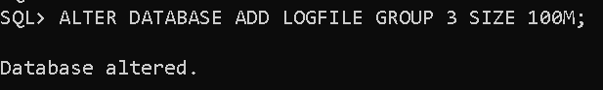
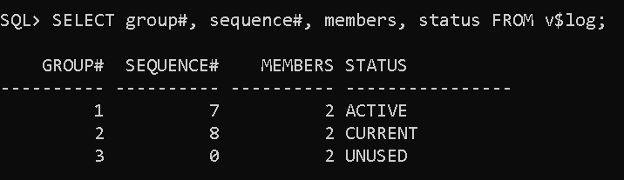
REDO LOG MULTIPLEXING:
By default Oracle has 2 minimum Redo log groups, as shown below:
We add another Redo log group, newly added logfile status will be UNSED

Slide 53
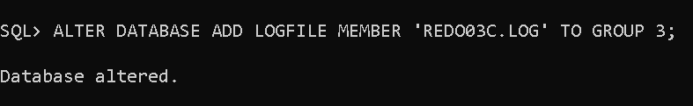
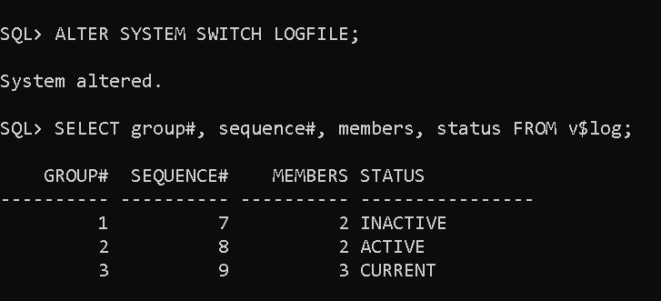
REDO LOG MULTIPLEXING (continue..):
Adding another member to Redo log group:
Switching Logfile:

Slide 54
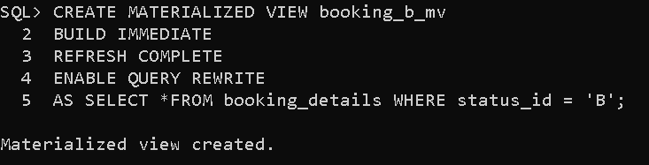

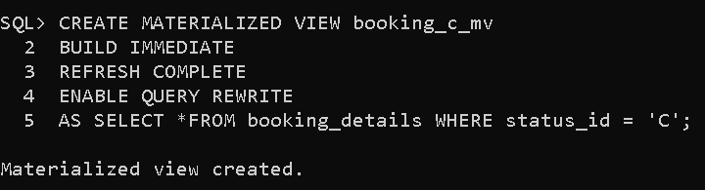
MATERIALIZED VIEWS:
Created Materiazlied view for checking Booking Details of customer whose status is Booked or Cancelled or Scratched, such query is used in some Procedures.

Slide 55
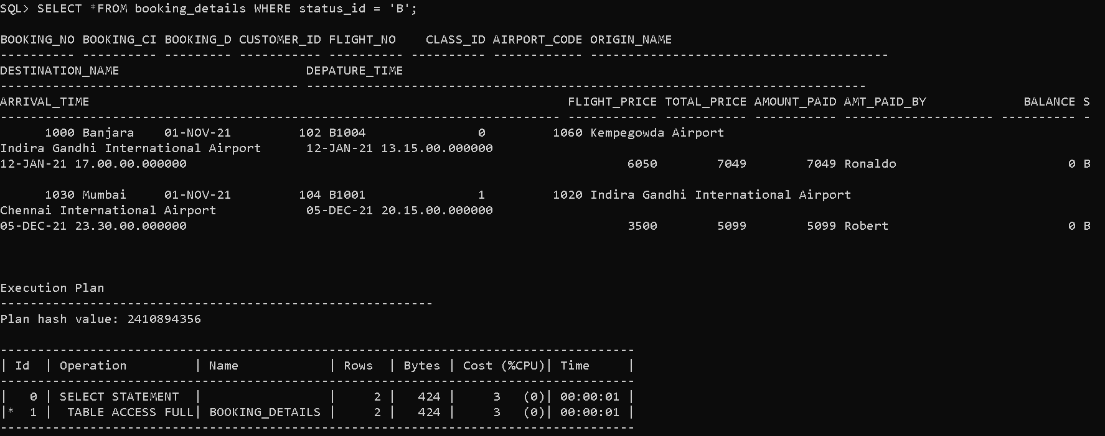
MATERIALIZED VIEWS:
Before (without Materialized Views)

Slide 56
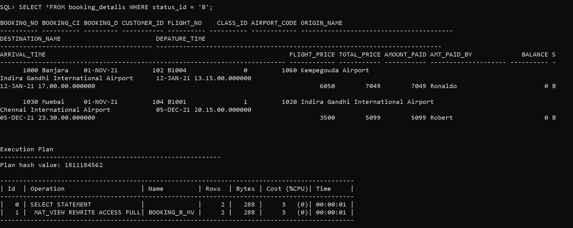
MATERIALIZED VIEWS:
After Creating Materialized Views

Slide 57
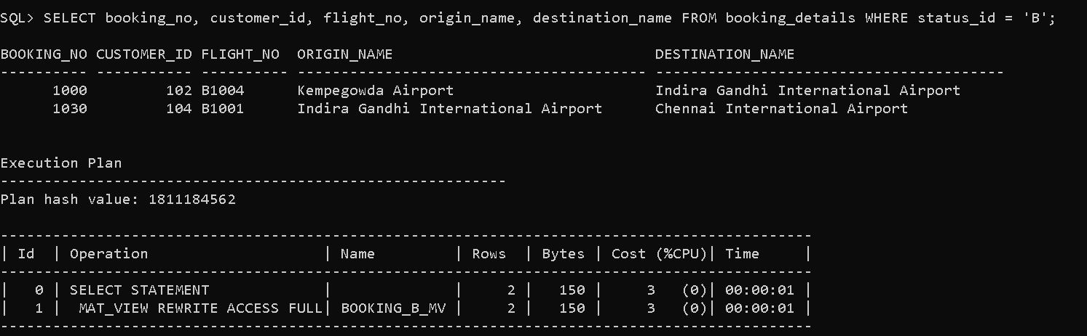
MATERIALIZED VIEWS:
Query Rewrite:
Supports in Enterprise Edition.

Slide 58
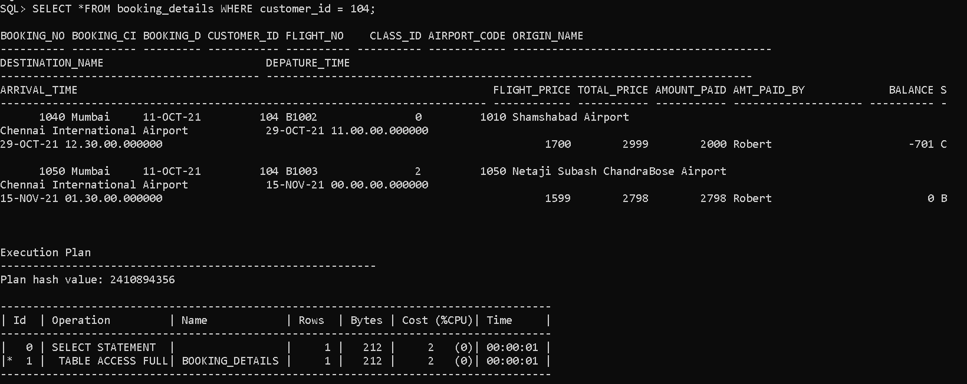
INDEXES:
Before (without INDEX)

Slide 59
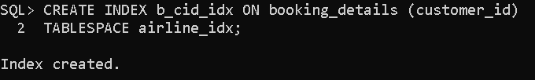
INDEXES:
Creating Index on Customer_ID :
Utilizing a separate TABLESPACE for INDEX.

Slide 60
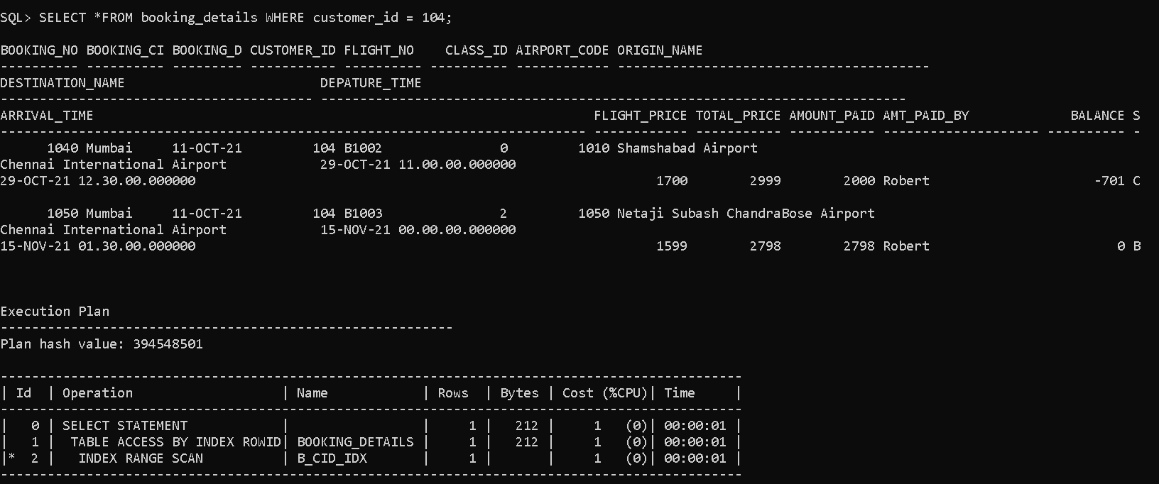
INDEXES:
After creating INDEX:

Slide 61
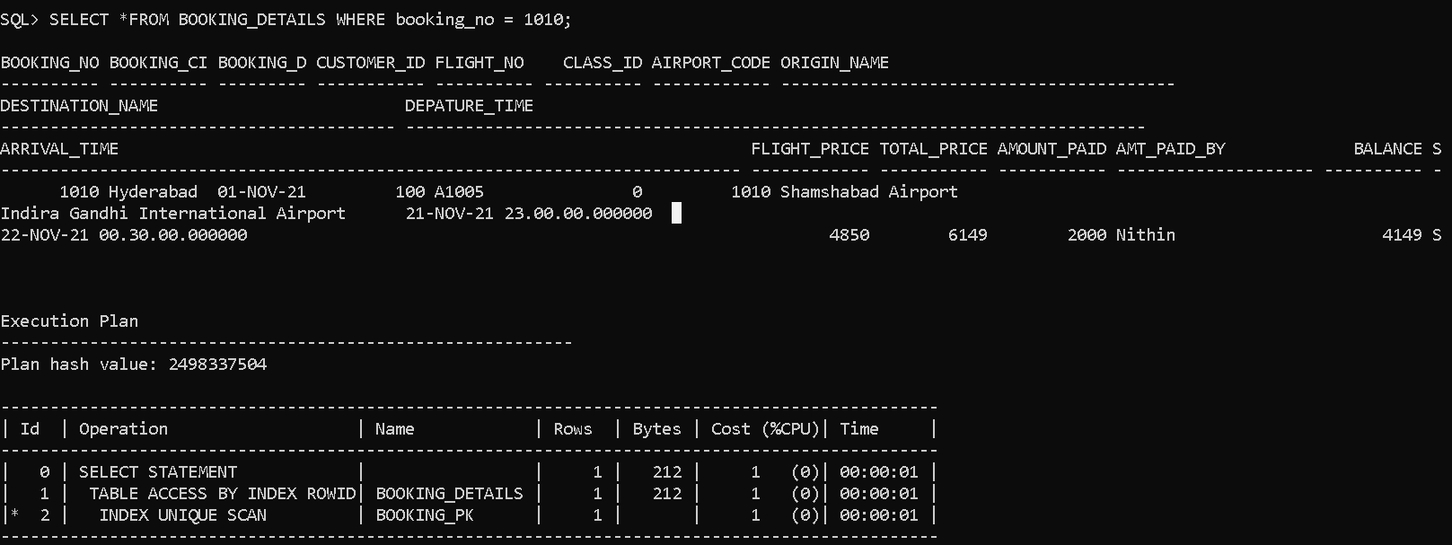
INDEXES:
For Primary Key Coloumn, oracle automatically creates Unique Index for that column:

Slide 62
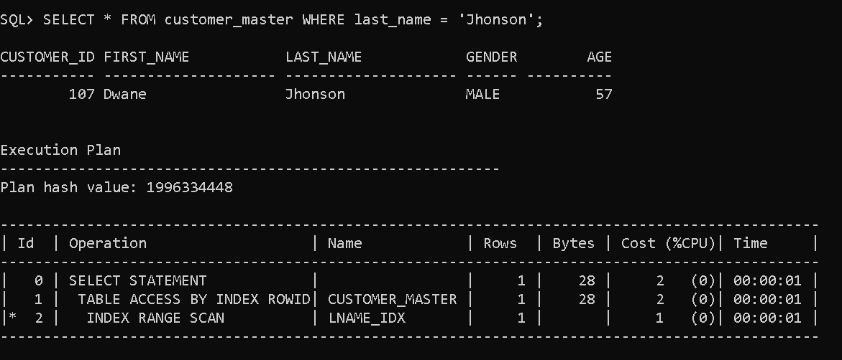
INDEXES:
Created INDEX on last_name in Customer_master TABLE:

Slide 63
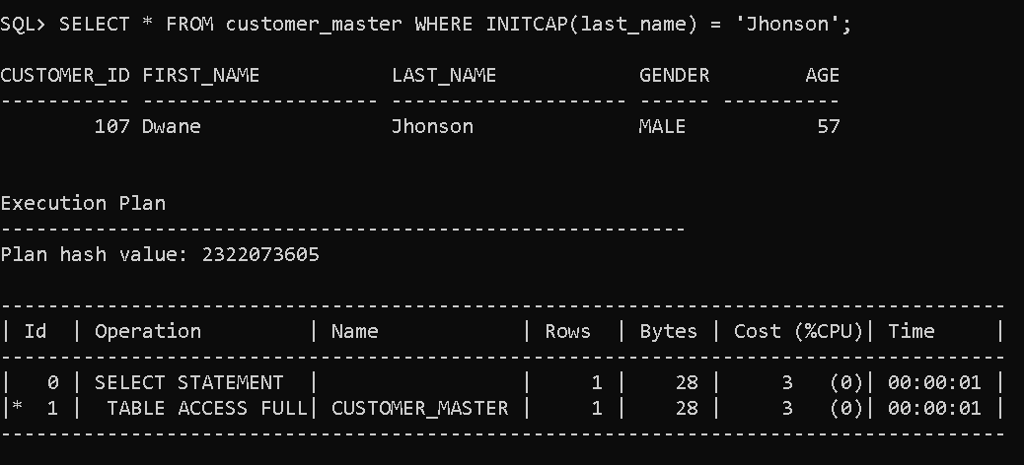
INDEXES:
When we use last_name with FUNCTION in WHERE clause:

Slide 64
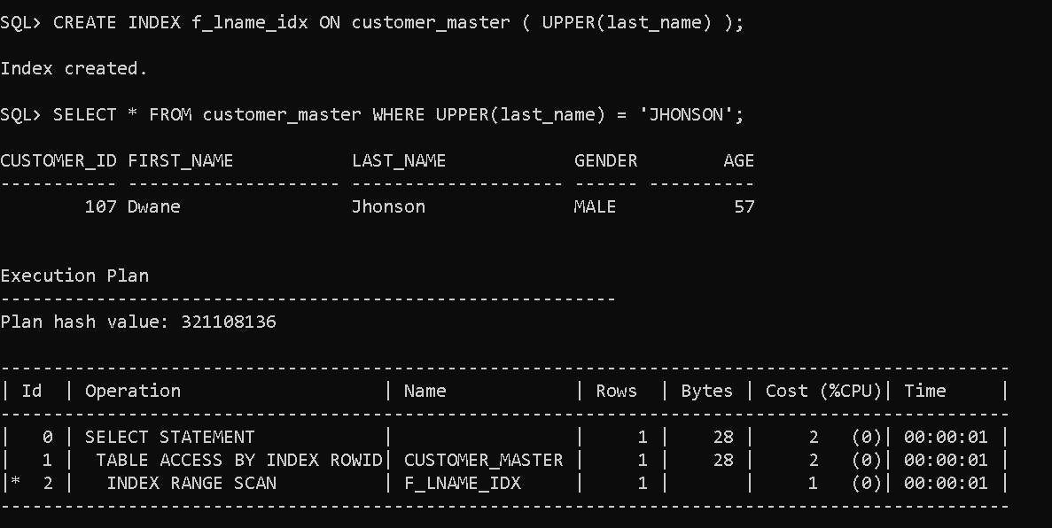
INDEXES:
FUNCTION BASED INDEX:

Slide 65
INDEXES:
GUIDELINES FOR USING INDEXES:
Create Index after Inserting Data.
Use Index for a valid columns.
Limit number of Indexs on a table.
Drop Indexes which are not longer required.
Use Index for a valid querying statements.
Examples: For a query fetching 90% of the data in table,
There is no use of having Index.
Use Index for searching less amount of data from large data tables.

Slide 66

JOINS:
Query utilized in Procedure 1 using JOINS with ON clause:

Slide 67

JOINS:
When utilized → JOIN with USING clause :

Slide 68

JOINS:
JOIN with USING clause is similar to NATURAL JOIN, but you cannot specifiy columns to be used to join.

Slide 69

JOINS:
There are different type of JOIN METHODS.
Oracle Optimizer chooses a Best Access path to retrieve data from tables using joins.

Slide 70

JOINS:
HASH JOIN

Slide 71

JOINS:
SORT-MERGE JOIN

Slide 72

JOINS:
NESTED LOOP JOIN

Slide 73

MONGODB
Creating Database is Simple in MongoDB:
use airline
Collections created:
Customer
Airport_master
Flight
Flight_availability
Login_details

Slide 74

MONGODB
db.createCollection(“customer”)

Slide 75

MONGODB
db.createCollection(“customer”)

Slide 76
MONGODB
Example:

Slide 77



MONGODB
Created all collections and displaying them using .find().pretty() command

Slide 78
TESTING PHASE:
UNIT TESING
INTEGRATION TESTING
SYSTEM TESTING
ACCEPTANCE TESTING
Test Integrated Components.
Individual Components
Test the entire system
Test the final system

Slide 79


TESTING PHASE:
Testing Procedure 1:
-> Testing Output with Correct Inputs:
-> Testing Output with Wrong Inputs:

Slide 80


TESTING PHASE:
Testing Procedure 2:
-> Testing Output with Correct Inputs:
-> Testing Output with Wrong Inputs:

Slide 81


TESTING PHASE:
Testing Procedure 3:
-> Testing Output of Correct Data:
-> Testing Output of No Data:

Slide 82


TESTING PHASE:
Testing Procedure 4:
-> Testing Output with Correct Data:
-> Testing Output with Wrong Data:

Slide 83

TESTING PHASE:
Testing Procedure 5:
-> Testing Output with Correct Inputs:

Slide 84


TESTING PHASE:
Testing Procedure 5 (Continue..):
->Testing Output with Wrong Data:
-> Testing Output with Wrong Password:

Slide 85


TESTING PHASE:
Testing Procedure 6:
-> Testing Output with Correct Inputs:
-> Testing Output with same correct Inputs Again:

Slide 86



TESTING PHASE:
Testing Procedure 6 (Continue..):
-> Testing Output with Wrong Booking_no:
-> Testing Output with Wrong Password:
-> Testing Output with Wrong Data:

Slide 87
TESTING SUMMARY
TEST_ID | TEST_CONDITION | INPUT DATA | OUTPUT DATA | RESULT
1 | GET_DETAILS | Correct Data: Customer_id = 100 | Number of bookings, emails, phones, faxs. | PASS
2 | GET_DETAILS | Wrong customer_id | Incorrect customer id | PASS
3 | CUSTOMER_DETAILS | Correct Data: Customer_id = 101 | Details of customer | PASS
4 | CUSTOMER_DETAILS | Wrong customer id | Please Enter correct customer id | PASS
5 | NO_BOOKINGS | --NO INPUT-- | Customer who doesn’t have any bookings. | PASS
6 | CANCELLED_BOOKINGS | --NO INPUT-- | Customer who have cancelled there Bookings | PASS
7 | BOOK_FLIGHT | Correct Data: User,password,origin,dest | Login Successful & Flight Booked | PASS
8 | BOOK_FLIGHT | Wrong Origin & Dest | No Data Found | PASS
9 | BOOK_FLIGHT | Wrong password | Shows incorrect password | PASS
10 | CANCEL_FLIGHT | With correct Data | Cancelled Flight & shows Remaining amount to deposied to customer bank | PASS
11 | CANCEL_FLIGHT | Again with same data | Flight Already Cancelled | PASS
12 | CANCEL_FLIGHT | Wrong data | No Data Found | PASS

Slide 88
SUMMARY
Created a Database.
Created Tables, Procedures, Functions, Packages, etc.. In User.
Tuning Methods:
Hints : NOCOPY, Paraller_Enable, Subprogram Inlining
Pragmas : Autonomous_transaction, Execption_init, Inline
Obfuscation
Bulk Binds
Redo Log Multiplexing
Materialized Views
Joins
Indexes

Slide 89


